Slide 1
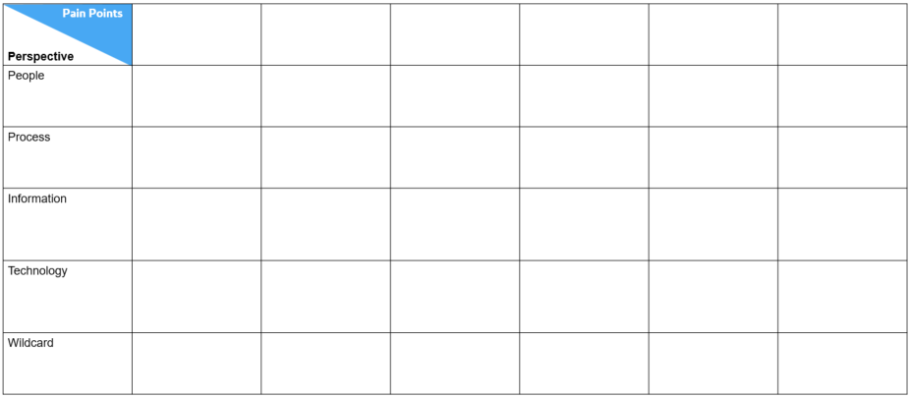
Idea Matrix Introduction
The Ideation Matrix considers each pain point and asks “How could we improve this – by changing any one of the dimensions of Capability?” (i.e., people process, information or technology).
Ideas or suggestions are added under each pain point for the relevant row. This is done in a non-critical way – any idea or suggestion is fair game.
The matrix helps us consider addressing the pain point problem from all angles, and stops us jumping at the ‘obvious’ solution.
Ideas or suggestions can be entered directly into the grip or via post-it available on the pallet
Pain
Pain
Pain
People
People
People
People
Process
Process
Process
Information
Information
Information
Technology
Technology
Technology
Wile Card
Wile Card

Slide 2
Idea Matrix
Perspective
People
Process
Information
Technology
Wildcard
Pain Points
Pallet
Pain
People
Process
Information
Technology
Wildcard

